Slide 1
DB Design
H.Melnyk

Slide 2
Agenda
Before start
Relations
Normalization
Integrity

Slide 3

Why Design?

Slide 4
Design
Defining the System Parameters
Defining the Work Processes
Building the Conceptual Data Model
Preparing the Database Schema
Designing the User Interface

Slide 5
Design
The objective of conceptual design is to obtain a good representation of the enterprise data resources, independent of the implementation level as well as the specific needs of each user or application.
The objective of logical design is to transform the conceptual schema by adapting it to the data model that implements the DBMS to be used (usually relational).

Slide 6
Database Design
Understanding the Problem
Taking Design Aspects into Account
Ability to Hold the Required Data
Ability to Support the Required Relationships
Ability to Solve the Problem
Ability to Impose Data Integrity
Ability to Impose Data Efficiency
Ability to Accommodate Future Change

Slide 7
Tasks
Design databases according to the option. Identify tables and data types in them.
1. “Publishing house.” Contains information about: books, their authors, editors, sales details, contracts.
2. "Cargo transportation". Contains information about: cars, drivers, customers, contracts, orders, destinations.
3. "Library". Contains information about: books, their authors, receipts, availability, disposal, departments, subscriptions.
4. "Human Resources Department". Contains information about: departments, positions, employees, salaries, payroll.
5. "Travel agency". Contains information about: tourist routes, sanatoriums and recreation centers, customers, orders, destinations, dates of departure and arrival, cost, availability of vacant vouchers.
6. “Student”. Contains information about: individual data of students, faculties, specialties of higher education, subjects and disciplines studied, teachers, results of sessions.
7. "Supply Department". Contains information about: employees of the department, warehouses, suppliers, settlements with suppliers, contracts, raw materials, their cost, date of receipt and transfer to production.
8. "Sales Department". Contains information about: employees of the department, warehouses, customers, orders, contracts, products, date of shipment.

Slide 8
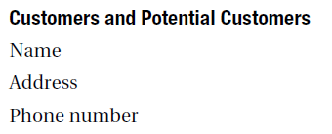
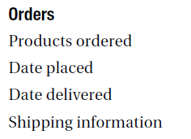
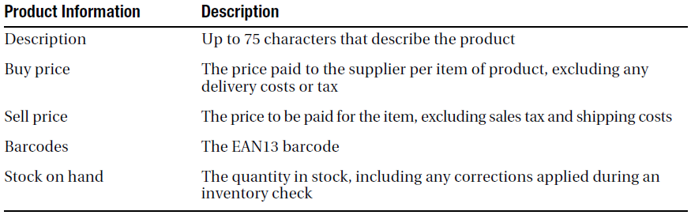
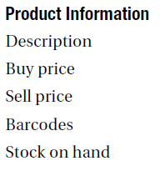
Stages in Database Design
Gathering Information
Developing a Logical Design
Determining Entities
https://go.gliffy.com/go/html5/launch

Slide 9
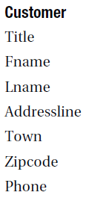
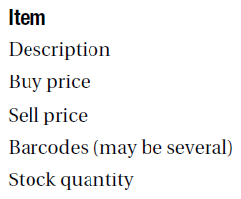
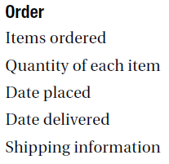
Stages in Database Design
Developing a Logical Design
Converting Entities to Tables

Slide 10
SQL Style. Naming
— Когда я был маленьким, у нас было три кошки. — И как их звали? — Кошка, кошка и кошка. — Ерунда какая-то. Как же вы их различали? — А какая разница? Кошки все равно на имена не откликаются!
Length
No special symbols
Strong rules of upper and low case

Slide 11
SQL Style. Naming
Create names according to ISO-11179
(http://pueblo.lbl.gov/~olken/X3L8/drafts/draft.docs.html
http://lists.oasis-open.org/archives/ubl-ndrsc/200111/msg00005.html)
The scalar data element must meet the following requirements:
1. It is unique (within its data dictionary).
2. It is named using the singular.
3. The name explains what the element is, not what it is not.
4. The name is read as a descriptive phrase.
5. The name contains only common abbreviations.
6. The name does not contain nested definitions of other data elements or concepts.
7. Tables, sets and other prefabricated elements are called generalizing concepts in the plural.
8. The name of the procedure contains a verb.
9. The name of the copy (alias) of the table includes the name of the base table and the reason for making a copy.

Slide 12
SQL Style. Naming
Levels of abstracts (ISO-3166 “Codes for the Representation of Names of Countries”)
trading_partner_country_name
No preffics
tbl- або vw - … Orders.ID=OrderlD … <type>+name=forder_nbr … РК_or FK_
Suffics standard system
_id – unique within schema (but not<table_name>_id)
_dt … _nbr … _ nm … _cd … _size … _tot … _seq … _tally … _cat … _class … _type
measure_of_height_of_the_tree
way of presentation
property
class

Slide 13
SQL Style. Naming
Table and representation names must be standard and presented as plural nouns.
Correlation names (aliases) are subject to the same rules as other names:
salary + commission AS total_pay
SELECT ... FROM Personnel AS Management, Personnel AS Workers
The names of relationship tables should be common, clear terms:
family = MaleFemale, but the exception is concatenation
Structural information can be included in the schema metadata access object names.

Slide 14
SQL Style. Naming errors
Avoid fuzzy names:
date… name… or contradiction - type_code_id
Avoid names that change from place to place
(The same attribute has a different name in different tables)
Do not use standard physical pointers
IDENTITY, GUID, ROWID

Slide 15

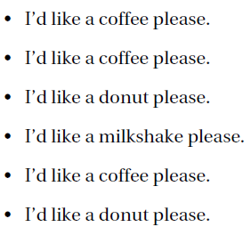
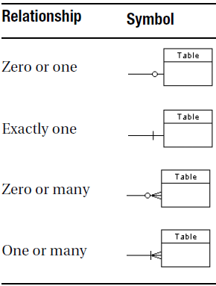
Stages in Database Design
Determining Relationships and Cardinality
Drawing Relationship Diagrams
Validating the Conceptual Design

Slide 16

Normalization
NORMALIZATION is a database design technique that reduces data redundancy and eliminates undesirable characteristics like Insertion, Update and Deletion Anomalies. Normalization rules divides larger tables into smaller tables and links them using relationships. The purpose of Normalization in SQL is to eliminate redundant (repetitive) data and ensure data is stored logically.
Notes:
для чого?
- для того шоб спростити процес дизайну/створення архітектури
- для того щоб був порядок
- для створення найбільш оптимізованої структуру БД:
- для економії памяті
- для легшого діставання дання?
- для того щоб якщо ви змінювали дані то не треба було того робити в 100500 місцях
- Коли одна колонка повинна помінятися, якшо міняється інша то це функціональна залежність

Slide 17
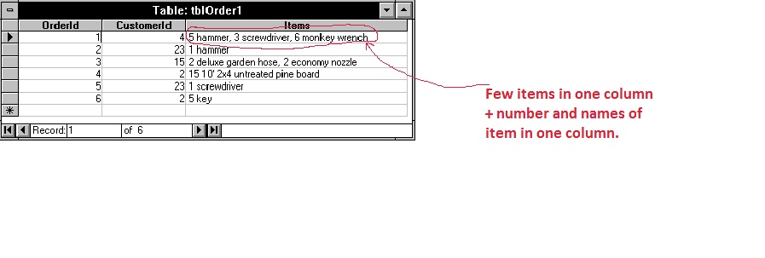
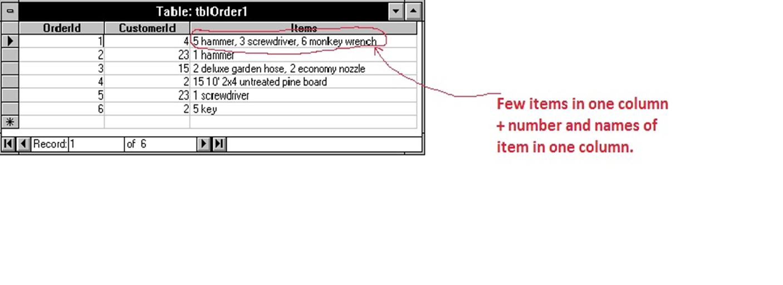
The 1st NF
Each table cell should contain a single value.
Each record needs to be unique.
SELECT ITEMS WHERE CustomerId = 4
Notes:
1. Нормальна форма: для кожної ячейки (cell) повинно бути лише одне значення (не список і не масив). Якшо декілька значнеь зберігаються в одній ячейці, то важко ними маніпулювати.
Перша нормальна форма має нічого проти того шоб значання в одній колонці повторювалися, але немає бути одинакових рядків.

Slide 18
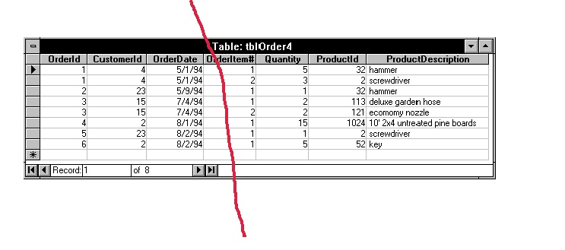
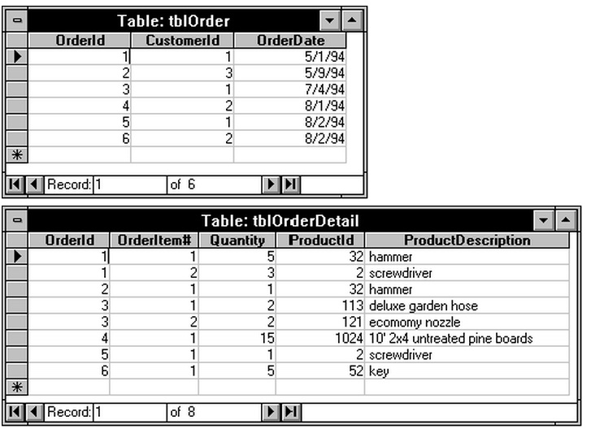
The 2nd NF
Rule 1- Be in 1NF
Rule 2- Single Column Primary Key
Notes:
2. Якшо таблиця в 1 нф + кожна не ключова колонка залежить від повного ключа:
- залежить від ключа
- залежить не від половини ключа а від цілого
Який замовник і коли замовив шось повністю визначається номером замовлення і зовсім не залежить від того скільки замовив користувач і від того який це порядковий номер у списку продуктів цього пордукта.
до другої нормальної форми доходять декомпозицією розбиттям на під таблиці, які потім треба якось обєднювати джойнами і отримувати результат на якись запит.

Slide 19
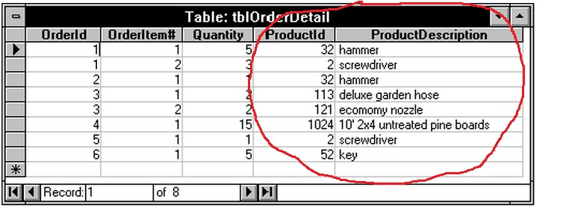
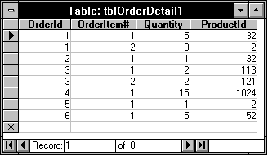
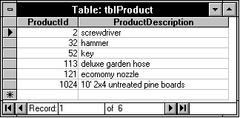
The 3rd NF
Rule 1- Be in 2NF
Rule 2- Has no transitive functional dependencies
Notes:
3. то така яка є в другій + якшо всі не ключові поля (колонки) взаємо незалежні (але в поняттях функціональної залежності). А це включає ціна1*ксть= загальна ціна (або активність користувача в Usage на Cloud Dashboard) => повинно сейвати місце... а в результаті ми вичитуємо два значення та шей тратим час на обрахунок (множення) при великій кількості таних це суттєво впиває на вибір даних тобто на аналітику.
+
випадок номер 2
проблема 1 попробуй поміняти шо 32 то старий мотоцикл а не хаммер
проблема 2 не будеш мати ніяких замовленні ніколи і не будеш знати шо хаммер то 32 має айдішку.
досягається декомпозицією

Slide 20
That's all to SQL Normalization!!!
BCNF (Boyce-Codd Normal Form)
Even when a database is in 3rd Normal Form, still there would be anomalies resulted if it has more than one Candidate Key.
Sometimes is BCNF is also referred as 3.5 Normal Form.
4NF (Fourth Normal Form) Rules
If no database table instance contains two or more, independent and multivalued data describing the relevant entity, then it is in 4th Normal Form.
5NF (Fifth Normal Form) Rules
A table is in 5th Normal Form only if it is in 4NF and it cannot be decomposed into any number of smaller tables without loss of data.
6NF (Sixth Normal Form) Proposed
6th Normal Form is not standardized, yet however, it is being discussed by database experts for some time. Hopefully, we would have a clear & standardized definition for 6th Normal Form in the near future...

Slide 21
Stages in Database Design
Converting to a Physical Model
Establishing Primary Keys
Establishing Foreign Keys

Slide 22
SQL style. DDL
If the table does not have a key, it is not a table
1. Natural key - a set of attributes from the table and acts as a unique identifier. It is visible to the user.
2. Artificial key - an additional attribute specifically entered into the table for use as a key. It is visible to the user, not directly related to the real data model, but can be checked by itself - by syntax, by control digit.
3. An explicit physical pointer is not based on a data model and is available to the user. Its value cannot be predicted or verified. The system calculates it based on the physical storage of data. Example: IDENTITY fields in the T-SQL family, other non-standard non-relational autonumbering tools, pointers based on cylinder numbers and Oracle hard disk tracks.
4. The system surrogate key is generated by the system to replace the real key based on the attributes in the table; not available to the user. Example: hashing algorithms. Surrogate keys are supported by the system.

Slide 23
Stages in Database Design
Converting to a Physical Model
Establishing Data Types

Slide 24
Stages in Database Design
Converting to a Physical Model
Completing the Table Definitions
Implementing Business Rules
Checking the Design

Slide 25
Stages in Database Design
Common Pattern
Many-to-Many
Hierarchy
Recursive Relationships

Slide 26

Physical Design

Slide 27
Thank you!

